Slide 1


Capstone Project
Sakila DVD Rentals
Notes:
Hi everyone,
My name is Shiraj Ahmad,
and I'm a mentor here for data science.
In this session, I'll be explaining Power BI's Capstone Project: Sakila DVD Rentals
First, congratulations on completing Excel, SQL, and Power BI.
After completing this Capstone Project, you'll be job-ready!
So, let's get started.

Slide 2
Overview
The Sakila database models the DVD rental store business, which contains content such as films, actors, inventory, stores, customers and staffs.
Customers and Sales
Inventory and Films
Staff and Stores
Demographic
Categories and Languages
Notes:
Overview of Power BI Dashboard for Sakila DVD Rental Store Database:
The Power BI Dashboard for the Sakila DVD Rental Store Database is a comprehensive tool designed to provide valuable insights into various aspects of the rental store business. The dashboard focuses on four key areas: Customers and Sales, Inventory and Films, Staff and Stores, and Demographics, Categories, and Language. By leveraging data from the Sakila database, the dashboard offers interactive visualizations and analytics to support data-driven decision-making and strategic planning.
Key Components:
1. Customers and Sales:
This section of the dashboard provides a detailed analysis of customer behavior and sales performance. It includes key metrics such as total revenue, sales trends over time, and sales by customer segments. Users can explore customer-specific data, identify high-value customers, and track customer retention. This analysis helps rental store owners optimize marketing strategies and improve customer satisfaction.
2. Inventory and Films:
The Inventory and Films section focuses on film inventory management and film performance. It showcases film categories, availability, and popularity based on rentals and returns. Users can identify top-performing film categories, stock popular films, and manage inventory levels efficiently. This analysis enables the rental store to ensure a diverse and appealing film collection for customers.
3. Staff and Stores:
This section provides insights into staff performance and store operations. It includes metrics such as employee sales, customer satisfaction ratings, and store revenue. Users can evaluate staff productivity, assess store performance, and identify areas for improvement. This analysis aids in optimizing staff allocation and enhancing overall store efficiency.
4. Demographics, Categories, and Language:
The Demographics, Categories, and Language section focuses on understanding customer demographics and film preferences. It presents visualizations of customer age groups, film categories, and languages preferred by customers. Rental store owners can use this information to tailor marketing efforts, offer personalized recommendations, and improve customer experiences.
In conclusion, the Power BI Dashboard for the Sakila DVD Rental Store Database offers valuable insights, guides business improvement, facilitates data-driven evaluations, and enhances the overall understanding of the rental store operations. By leveraging these insights, rental store owners can make informed decisions, optimize film inventory, improve customer satisfaction, and achieve sustained success in the competitive DVD rental market.

Slide 3

Problem Statement
Objective
Analysis Scope
Goal
Insights & Recommendations.
Report & Presentation
Notes:
Problem Statement for Power BI Dashboard using Sakila DVD Rental Store Database:
Objective:
The objective of this project is to develop a comprehensive Power BI dashboard using the Sakila DVD Rental Store Database. The dashboard aims to provide valuable insights into the rental store business, including customer behavior, film inventory management, staff performance, and store operations. The primary focus is to enable data-driven decision-making and improve overall business performance.
Analysis Scope:
The analysis will cover four key areas: Customers and Sales, Inventory and Films, Staff and Stores, and Demographics, Categories, and Language. It will include customer segmentation, sales trends, film performance, staff productivity, and store revenue. The analysis will span historical data to uncover trends and patterns for informed decision-making.
Goal:
The primary goal of the Power BI dashboard is to empower rental store owners with actionable insights. The dashboard aims to optimize film inventory, enhance customer satisfaction, improve staff performance, and streamline store operations. By understanding customer preferences and behavior, the goal is to offer personalized film recommendations and targeted marketing strategies to increase customer engagement and loyalty.
Insights & Recommendations:
The Power BI dashboard will provide valuable insights into customer preferences, popular film categories, peak rental periods, and staff productivity. It will identify high-value customers, top-performing films, and opportunities for optimizing inventory levels. Based on the analysis, the dashboard will recommend targeted marketing campaigns, film collection enhancements, and staff training initiatives to improve overall business performance.
Report & Presentation:
The final deliverables will include a comprehensive report detailing the data sources, data modeling, and data cleaning processes used to create the Power BI dashboard. The report will present key insights derived from the dashboard's analysis and outline actionable recommendations for business improvement. The presentation will showcase the dashboard's visualizations, the significance of the findings, and how stakeholders can utilize the dashboard for effective decision-making.
The Power BI dashboard, along with the report and presentation, will serve as a valuable tool for rental store owners to gain a deeper understanding of their business. It will enable them to make informed decisions, optimize film inventory, enhance customer satisfaction, and achieve growth and success in the competitive DVD rental market.

Slide 4


Significance
Valuable insights
Improvement focus
Evaluation of effectiveness
Trend identification
Comprehensive understanding
Notes:
Significance of Power BI Dashboard using Sakila DVD Rental Store Database:
Valuable Insights:
The Power BI Dashboard offers valuable insights into the rental store business, including customer behavior, film inventory management, staff performance, and store operations. These insights empower rental store owners to make informed decisions, identify customer preferences, and optimize business strategies.
Improvement Focus:
By analyzing customer segmentation, film performance, and staff productivity, the dashboard helps rental store owners focus on areas that require improvement. It identifies low-performing films, opportunities for enhancing customer satisfaction, and areas for staff training and development.
Evaluation of Effectiveness:
The dashboard facilitates the evaluation of various rental store strategies and initiatives. It allows rental store owners to assess the effectiveness of marketing campaigns, the popularity of film categories, and the impact of customer engagement efforts. This evaluation guides owners in refining their approaches and allocating resources effectively.
Trend Identification:
Through trend analysis, the dashboard identifies patterns in customer behavior, film preferences, and rental trends. It helps rental store owners understand peak rental periods, popular film categories, and seasonal variations in demand. Identifying trends enables proactive planning and adapting strategies to changing market dynamics.
Comprehensive Understanding:
The Power BI Dashboard provides a comprehensive understanding of the rental store business by consolidating data from various aspects, such as customer behavior, film inventory, staff performance, and store operations. This holistic view enables rental store owners to grasp the overall performance and dynamics of the business.
In conclusion, the Power BI Dashboard using the Sakila DVD Rental Store Database offers valuable insights, guides improvement efforts, facilitates data-driven evaluations, identifies trends, and provides a comprehensive understanding of the rental store business. By leveraging these insights, rental store owners can make informed decisions, optimize operations, enhance customer satisfaction, and achieve sustained success in the competitive DVD rental market.

Slide 5
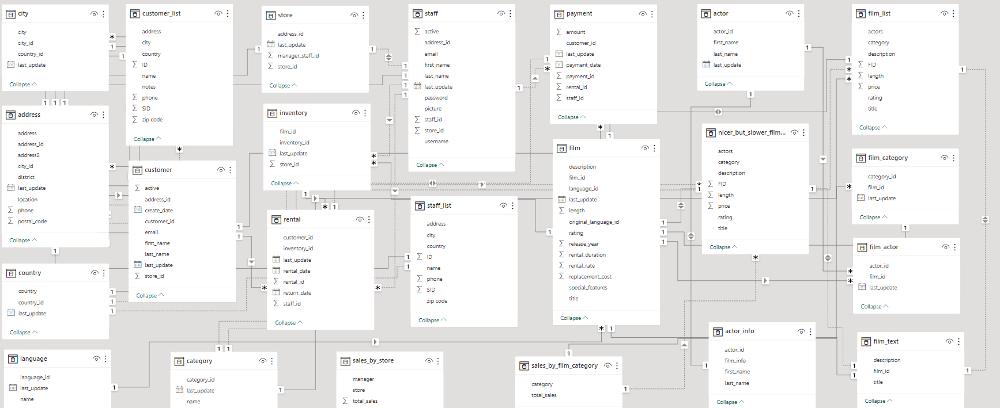
ER Diagram
Notes:
Now that we have comprehended the problem statement and recognized the significance of the project, let's delve into a thorough understanding of the dataset.
The Entity-Relationship (ER) diagram for the Power BI Dashboard using the above database represents the relationships and interactions between various entities (tables) in the database. Here's an explanation of the ER diagram based on the provided tables:
Entities:
1. City: Represents different cities where the rental stores are located. Each city is identified by a unique city ID and contains attributes such as city name and postal code.
2. Address: Stores address details for various entities like customers and stores. Each address is identified by a unique address ID and includes attributes like street address, district, and postal code.
3. Country: Contains information about different countries. Each country is identified by a unique country ID and may have attributes like country name and region.
4. Language: Represents different languages in which films are available. Each language is identified by a unique language ID and may have attributes like language name.
5. Customer_List: Serves as a junction table between customers and rental stores. It stores information about the customers associated with specific rental stores.
6. Customer: Contains details about individual customers who rent films. Each customer is identified by a unique customer ID and includes attributes such as customer name, email, and membership details.
7. Category: Represents film categories or genres. Each category is identified by a unique category ID and includes attributes like category name.
8. Store: Represents individual rental stores. Each store is identified by a unique store ID and contains attributes like store name, manager staff ID (foreign key), and address ID (foreign key).
9. Inventory: Stores film inventory information for each rental store. It includes film ID (foreign key) and store ID (foreign key).
10. Rental: Records film rental transactions. It includes rental ID, rental date, return date, customer ID (foreign key), staff ID (foreign key), and inventory ID (foreign key).
11. Sales_by_Store: Contains sales data grouped by store. It includes attributes such as store ID (foreign key) and total sales.
12. Sales_by_Film_Category: Contains sales data grouped by film category. It includes attributes such as category ID (foreign key) and total sales.
13. Actor_Info: Contains actor information, including actor ID (foreign key), first name, and last name.
14. Film_Text: Stores film description and additional textual data for films. It includes film ID (foreign key) and film description.
15. Staff: Represents staff members working at rental stores. Each staff member is identified by a unique staff ID and contains attributes such as staff name, email, and store ID (foreign key).
16. Staff_List: Serves as a junction table between staff and rental stores, storing information about staff members associated with specific rental stores.
17. Payment: Records payment transactions for film rentals. It includes payment ID, payment date, rental ID (foreign key), and payment amount.
18. Film: Contains details about individual films available for rent. Each film is identified by a unique film ID and includes attributes such as film title, release year, and rental duration.
19. Actor: Represents individual actors. Each actor is identified by a unique actor ID and includes attributes like actor name and gender.
20. Nicer_But_Slower_Film: Contains data about films considered "nicer but slower" versions of original films. It includes film ID (foreign key) and additional film details.
21. Film_List: Serves as a junction table between films and categories, linking films to their corresponding categories.
22. Film_Category: Represents the relationship between films and categories. Each film can belong to multiple categories, and each category can have multiple films.
23. Film_Actor: Represents the relationship between films and actors. Each film can have multiple actors, and each actor can appear in multiple films.
The ER diagram visually presents the structure and relationships of the database, facilitating better understanding and design of the Power BI Dashboard. It provides a clear representation of data entities and their connections, enabling effective data analysis and visualization within the Power BI Dashboard.
I trust that you now have a clear understanding of the Capstone project requirements.

